Slide 1




4
Unit 5 Section A
Speaking Chinese in America
FOREIGH LANGUAGE TEACHING AND RESEARCH PRESS
AIR FORCE ENGINEERING UNIVERTISY
Notes:
1

Slide 2

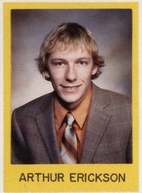
4
5
UNIT
Each of us is like everybody else in some ways (universal behaviors), like the people in our culture in some other ways (cultural behaviors), and like no one else at all in still other ways (personal behaviors).
— Craig Storti (American scholar)
Our incapacity to comprehend other cultures stems from our insistence on measuring things in our own terms.
— Arthur Erickson (Canadian architect)
Notes:
2

Slide 3

^{Section A}
4
5
Why culture counts
UNIT
Speaking Chinese in America
To talk about a stereotype of Chinese
language and culture
Objectives
To further understand the text
To apply the phrases and patterns
To master the paragraph (essay) writing
skill

Slide 4







5
Speaking Chinese in America
UNIT
Contents
Warming-up Activities
Text Study
Language Application
Summary

Slide 5
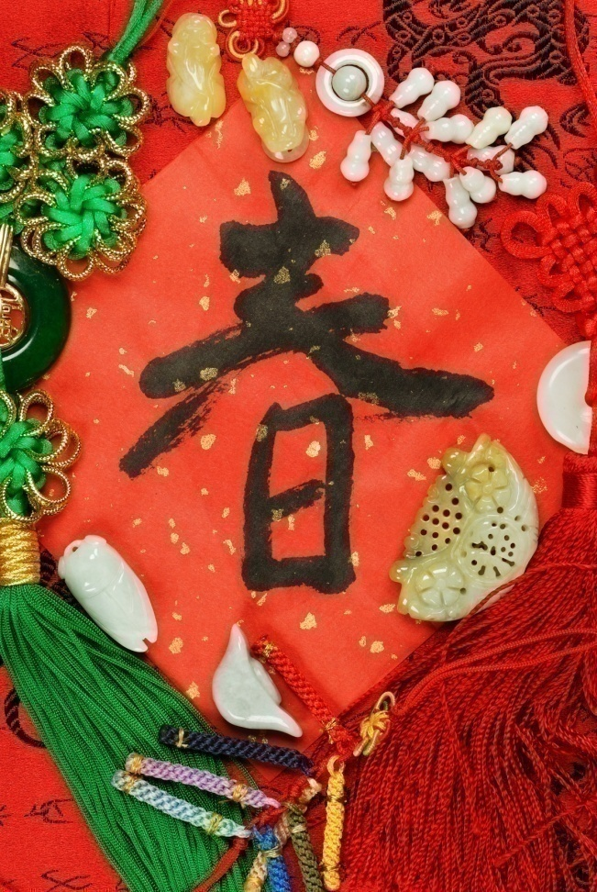



5
UNIT
Speaking Chinese in America
Warming-up Activities
Lead-in
Pre-reading Activities
Cultural Background

Slide 6

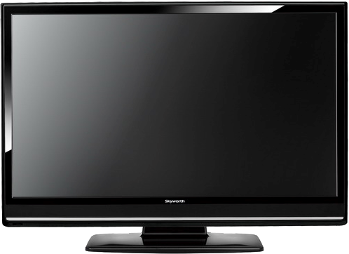
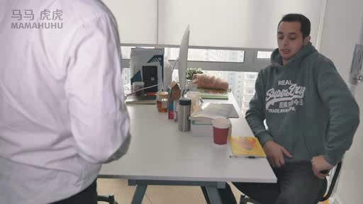

Slide 7

Some Westerners think that Chinese people tend
to avoid saying “no” directly. What are the common ways in which the Chinese express disagreement, rejection or refusal in daily communication?
Chinese people generally use expressions like “possibly no” or “I’m afraid it won’t work” to say “no” to others. This makes them less direct in giving rejections.

Slide 8
2. Are all Chinese so “discreet and modest” that
there aren’t even words for “no”?
No. When people with greater authority or power say “no” to those in a lower status (e.g. parents to children), they can be very direct and straightforward, e. g. “absolutely no”.

Slide 9


Listen to a radio program on compliments in American English. Complete the answers to the following questions according to what you hear.
What are the common structures Americans use to compliment each other?
(a) What a …! (e.g. “What a nice hat!”)
(b) ____________________________________.
(Give one structure and one example)
2. Are there any differences between Chinese and
American cultures in how people compliment each
other and how they respond to a compliment?

Slide 10

1. What are the common structures Americans
use to compliment each other?
(a) What a …! (e.g. “What a nice hat!”)
(b) ___________________________________
(Give one structure and one example)
I like your … (e.g. “I like your hat.”)
I love your … (e.g. “I love your shoes.”)

Slide 11
Are there any differences between Chinese and American cultures in how people compliment each other and how they respond to a compliment?
Yes, the traditional way is to say something to show that we or the object we own is not that good. For example, we may say “哪里” (meaning “it is nothing”). But in modern days, many people have adopted the English way of responding to a compliment. They say “thank you” very often too.

Slide 12


Listen to a short passage and fill in the missing information.
China is casting such a huge __________ on the United States that many Americans are ______________ to learn the Chinese language _____________ retain their competitive edge. “Interest in learning Chinese among American youth and their parents has grown dramatically in the past five years.”
shadow
scrambling
in a bid to
To be continued

Slide 13
Listen to a short passage and fill in the missing information.
said Vivien Stewart, vice president at the Asia Society, a US group trying to __________________ between Americans and the peoples of Asia and the Pacific. China’s dramatic rise to near superpower ________ and its telling effects politically, economically,
bridge the gap
status
To be continued

Slide 14
Listen to a short passage and fill in the missing information.
culturally
and ___________ are driving the interest to learn the language, experts say. From
_________________ to high schools, studies by the Asia Society show, there is a “rapid rise” in __________ among pupils to study the Chinese language. ”
kindergartens
interest
To be continued

Slide 15
Listen to a short passage and fill in the missing information.
The Chinese rich cultural traditions and blossoming economy mean that is now ______________ all of our students to be better prepared to engage them and _______ opportunities together,” said Michael Levine, Asia Society’s executive director of education.
essential for
seize

Slide 16


Cultural Background
Chinese Americans
Questions Previewing
1. What does Chinese Americans refer to?
Tips
2. What stereotypes of Chinese Americans are
depicted in the media?
Tips
3. What are the popular columns in the history
of the New York Times Magazine?
Tips

Slide 17


Cultural Background
the United Arab Emirates
1. What does Chinese Americans refer to?
The term “Chinese Americans” refers to Americans of Chinese descent. It also includes those with partial Chinese ancestry.

Slide 18
Cultural Background
the United Arab Emirates
2. What stereotypes of Chinese Americans
are depicted in the media?
Chinese Americans are “foreign” and “unassimilated”.
Chinese are alien predators.
Chinese Americans are restricted to
clichéd occupations.
Chinese Americans are polite.
Chinese Americans as a whole are a
model minority.

Slide 19
Cultural Background
the United Arab Emirates
3. What are the popular columns in the history
of the New York Times Magazine?
Some of the popular columns in the history of the magazine are “On Language”, “The Ethicist”, “Consumed”, and “The Funny Pages”.

Slide 20


5
Speaking Chinese in America
UNIT
Text Study
Main Idea & Structure
Language Focus
Critical Thinking

Slide 21


Why did the author’s mother describe her Sau-sau by using the expression “nominal courtesy” at the dinner? (Para.1)
Tips
She just pretended to be polite. (ate up the dish in the end; although she didn’t want it at first.)

Slide 22
When the author’s mother offered the last
scallop from the garlic seafood dish, Sau-sau’s response: (Para.2)
B’yao, zhen b’yao!
(Para.3)
Full, I’m already full. (Para.5)
Sighed.
(Para. 7)
Notes:
22

Slide 23
What did the author’s mother suggest as the right way for the Chinese to respond at the dinner table in America? (Para. 8)
Tips
They say directly whether they want to have anything or not. They would rather than refuse for the sake of
politeness even if they in fact want to eat it.
Notes:
23

Slide 24

Part I — (Paras. 1- __)
9
A story about a family dinner to introduce the topic of the essay, i.e. whether Chinese language
and culture are _______________.
indirect and polite

Slide 25
Main Idea & Structure
Main Ideas of the Parts
How did the article in The New York Times Magazine describe Chinese language and culture? (Para.10)
Tips
It said that Chinese language and culture were very indirect and polite.
Notes:
25

Slide 26
As any child of immigrant parents knows, there is a special kind of _______________ attached to knowing two languages. (Para.12)
double bind
Notes:
26

Slide 27

Why did the author’s parents scold her when she answered them with a question? (Paras.13-17)
Tips
They thought that she was not
respectful if she questioned them.
Notes:
27

Slide 28
If I consider my upbringing carefully, I find there was nothing __________ about the Chinese language I grew up with, no censorship for the sake of _____________. My parents made everything abundantly clear in their _______________ demands: “Of course you will become a famous aerospace engineer,” they prodded. (Para.18)
discreet
politeness
consecutive

Slide 29
not reliable
Para. 20
Having listened to both Chinese and English, I’m suspicious of ____________ between the two languages, as I notice the reciprocal ____________ they each present. English speakers say Chinese is extremely difficult because different words can be denoted by very subtle variations in tone. English is often bracketed with the label of _____________, a language of too many broken rules.
comparisons
challenges
inconsistency

Slide 30

In Paragraph 21, the author mentions how an outside observer might view Chinese people by just listening to her mother speak. Why does she discuss this?
Tips
To support her opinion that to understand the difference between languages and behavior just through literal translation may lead to wrong generalizations.
Notes:
30

Slide 31
What did the author worry? (Para. 22)
Tips
See Chinese people from a limited
perspective;
Lead to actual intolerance and few
Chinese in top management positions;
The power of language.
Notes:
31

Slide 32
How does the author feel about the description of Chinese people as being “modest and polite”? (Para. 24)
Tips
She feels that it is annoying because
such a description does not express new ideas, honest emotions or considered thought.
Notes:
32

Slide 33
Part II — (Paras. 10-26)
The author examines in detail the American view about Chinese language and culture and rebuts it with stories and observations from her own life.

Slide 34
According to the text, how do Chinese people say “yes” or “no” when answering questions? (Para. 28)
Tips
Saying something specific to what is asked because there is no one word in Chinese for “yes” or “no”.
Referring directly to the proposition being asserted or denied.
Notes:
34

Slide 35
Part III — (Paras. 27-31)
There is no one word in Chinese for “yes” or “no”, which is not because Chinese people are discreet, but because their answer is specific to what is asked.

Slide 36

Introduction
A story about a family dinner to introduce the topic of the essay, i.e. whether Chinese language and culture are indirect and polite. (Paras. 1-9)

Slide 37
Introduction
Body
Refutation against the American view that Chinese language and culture are indirect and polite. (Paras. 10-26)

Slide 38
Introduction
Body
Conclusion
There is no one word in Chinese for “yes” or “no”, which is not because Chinese people are discreet, but because their answer is specific to what is asked. (Paras. 27-31)

Slide 39
Introduction
Body
Conclusion

Slide 40

Speaking Chinese in America
Once, at a dinner, my mother whispered to me confidentially: “Sau-sau pretends too hard to be a polite __________! Why bother with such nominal ___________? In the end, she always takes everything.” My mother no longer patient with old taboos and courtesies.
recipient
courtesy
To be continued

Slide 41
I read an article in The New York Times Magazine, where the author mentioned that the interwoven _______________ of Chinese language and culture renders its speech indirect and polite. Chinese people are so “_________ and modest”, that there aren’t even words for “yes” and “no”.
configuration
discreet
To be continued

Slide 42
If I consider my upbringing carefully, I find there was nothing discreet about the Chinese language I grew up with, no ____________ for the sake of politeness. Having listened to both Chinese and English, I’m ______________ comparisons between the two languages, as I notice the reciprocal challenges they each present.
censorship
suspicious of
To be continued

Slide 43
Even more dangerous is the temptation to view the _____ between different languages and behavior in translation. There is no one word for “yes” or “no”, but not _________________ to be discreet. ____________, I would say the Chinese equivalent of answering “yes” or “no” is specific to what is asked.
gulf
out of necessity
If anything

Slide 44

Practical Phrases | Specific Meanings
1. be attached to | 与……有联系
2. on the side | 作为副业；作为兼职
3. get / come to the point | 切入主题
4. hedge … in with / by … | 以……限制某人（的自由、 机会等）； 包围；围住
5. be representative of | 有代表性的；代表……的
6. if anything | 如果有什么不同；甚至正 相反；甚至还不如说

Slide 45

与……有联系
短语逆译
be attached to
短语应用
不要担心，因为这仅是意外，学生不应该受到指责。
意群提示
(an accident / blame / be attached to)
Don’t worry because it was an accident and no blame is attached to students.

Slide 46
作为副业；作为兼职
短语逆译
on the side
短语应用
她的丈夫是个医生，业余时间做些雕塑。
意群提示
(make sculptures / on the side)
Her husband is a doctor who makes sculptures on the side.

Slide 47
切入主题
get / come to the point
短语逆译
短语应用
我们时间不多，所以我就直入主题吧。
意群提示
(not have much time / come to the point)
We don’t have much time, so I’ll come straight to the point.

Slide 48
以……限制某人（的自由、机会等）； 包围；围住
hedge … in with / by …
短语逆译
短语应用
很明显，政客们通常受到本身利益的制约。
意群提示
(politicians / hedge in with)
It is clear that politicians are often hedged in with their own interests.

Slide 49
有代表性的；代表……的
be representative of
短语逆译
短语应用
这些短篇小说代表了20世纪具有主导性的文学主题。
意群提示
(be representative of / dominant / literary themes )
These short stories are representative of the dominant literary themes of the 20th century.

Slide 50
如果有什么不同；甚至正相反；甚至还不如说
短语逆译
if anything
短语应用
小明看上去对输掉比赛并不是太失望。相反，
他好像因为比赛都已结束而感到如释重负。
意群提示
(losing / if anything / relieve)
Xiao Ming didn’t seem too disappointed at losing. If anything, he seemed relieved that it was all over.

Slide 51

Functional Patterns | Functions & Usages
1. Why + v. / n. / prep. phrase | 用于含蓄地表达观点。
2. If I consider my upbringing carefully, I find there was nothing discreet / important about sth. / sb. I grew up with…. | 用于表示“通过个人经历而形成的对某人/事的正确认识”。
3. At this junction, I do agree in part with sth. | 用于表示“部分认同”。
Notes:
51

Slide 52
原句译文
何必费劲讲究形式上的客套呢？
逆译练习
Why bother with such nominal courtesy?
句型提炼
Notes:
52

Slide 53

句型提炼
why + v. / n. / prep. phrase
应用提示
用于含蓄地表达观点。
句型应用
Notes:
53

Slide 54
典型例句
你可以在电脑上看电视节目，何必费劲买个
电视机呢？
意群提示
(TV program)
You can watch TV programs on the computer, so why a television?

Slide 55
原句译文
仔细想想自己的成长过程，我发现，我从小到大所接触到的中文并不是什么特别谨慎的语言。
逆译练习
If I consider my upbringing carefully, I find there was nothing discreet about the Chinese language I grew up with.
句型提炼
Notes:
55

Slide 56
句型提炼
If I consider my upbringing carefully, I find there was nothing discreet / difficult about sth. / sb. I grew up with….
应用提示
用于表达“通过个人经历而形成的对某人/事的正确认识”。
句型应用
Notes:
56

Slide 57
典型例句
仔细想想自己的成长过程，我发现，我从小到大所接触到的英文并不是什么特别难的语言。
意群提示
(upbringing / grow up with)
If I consider my upbringing carefully, I find there was nothing difficult about the English language I grew up with.

Slide 58
原句译文
在这一点上，我的确在某种程度上同意《纽约时报杂志》的那篇文章。
逆译练习
At this junction, I do agree in part with The New York Times Magazine article.
句型提炼
Notes:
58

Slide 59
句型提炼
At this junction, I do agree in part with sth.
应用提示
用于表达“部分认同”。
句型应用
Notes:
59

Slide 60
典型例句
在这一点上，我的确在某种程度上同意女孩要富养的理念。
意群提示
(At this junction / agree in part with / raise)
At this junction, I do agree in part with the idea that daughters should be raised in richness and happiness.

Slide 61



a. As any child of immigrant parents knows, there is a special kind of double bind attached to knowing two languages. (Para. 12，L1)
生于移民家庭的孩子都清楚，有一种特殊的两难境地与说两种语言的生活联系在一起。

Slide 62
b. Having listened to both Chinese and English, I’m suspicious of comparisons between the two languages, as I notice the reciprocal challenges they each present. (Para. 20, L1)
由于一直同时听着中英文两种语言，故而我对它们之间的任何对比总是心存怀疑，因为我注意到它们各自都有对方所没有的难点。

Slide 63
我担心语言的力量，即如果一个人将一件事说了很多遍，无论其是否有恶意，这件事都会变成事实。
c. I worry about the power of language: If one says anything enough times, it might become true with or without malicious intent. (Para. 22,L4)

Slide 64



1 Do you know of any stereotype of a foreign country, its people, or its language? Have you ever met anyone who either fits or contradicts this image, and in what way?
Tips
If you are going to live in a foreign country for a number of years, what would you prefer to do: to adapt your behavior and manners to the culture of that country, or to stick to the norms of your own culture?
Tips

Slide 65

Do you know of any stereotype of a foreign
country, its people, or its language? Have you ever met anyone who either fits or contradicts this image, and in what way?
• Yes. French people are romantic, and the French
language is beautiful; Italians are fashionable,
and Italy has the best cuisine in the world. I
have watched many movies in which French
people are indeed romantic, although I have
never met any French in person. A common
scene in the movies is that a French man gives
flowers to his girlfriend or wife, or two persons
meet by chance and fall in love quickly.
• No. I think people in different countries or
cultures of the world have more similarities than
differences. For instance, we all consider such
values as honesty, diligence and patriotism
important qualities of being a good man or a
good citizen. Hence, I think there are no essential
differences between peoples or cultures, and
I don’t have any stereotype of any foreign
country, its people, or its language.

Slide 66
2. If you are going to live in a foreign country for
a number of years, what would you prefer to
do: to adapt your behavior and manners to
the culture of that country, or to stick to the
norms of your own culture?
Tips
• I will try to adapt my habits to local norms.
For example, I will follow their rules of
dining, body language and gift giving.
• I would prefer to maintain Chinese traditions.
Modern people value cultural diversity, so, I
think people of the foreign country I live in
will respect my choice.

Slide 67




Watch a video clip and discuss the following question.
What would you suggest as good ways for people to avoid misunderstandings of foreign cultures?
Tips
Video Watching

Slide 68
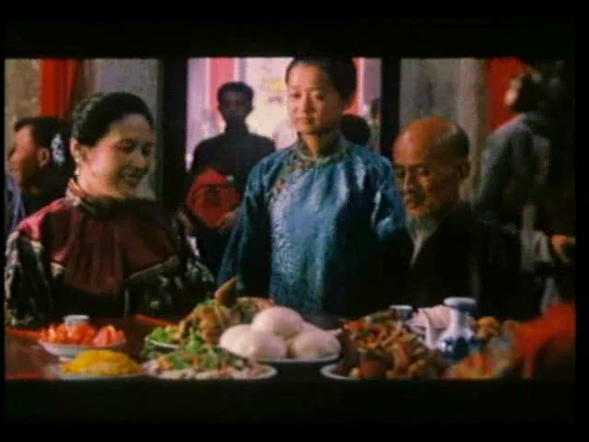
Back

Slide 69
What would you suggest as good ways for people to avoid misunderstandings of foreign cultures?
Look for information about those cultures;
Visit foreign countries, which will enable us to experience their cultures in person and understand them better;
Make friends with foreigners who are traveling or are living in our country; Communicating with them in daily life will help us know their customs.
Tips

Slide 70

5
Speaking Chinese in America
UNIT
Language Application
Writing Devices
Oral Reproduction
Paragraph Translation

Slide 71

Write a narrative with direct dialog
A narrative essay tells a story. Important elements that make up a story include a setting (the location), a theme (the basic idea), a mood (the feeling or atmosphere), characters (people), and a plot (the sequence of events). One way to present these elements is to use dialog. A good narrative essay often employs vivid dialog, through which it can bring characters to life and effectively arouse readers’ emotional responses.
to be continued

Slide 72
Write a narrative with direct dialog
Dialog is the verbal exchanges between two or more characters. There are two ways to tell the words of the characters. One is direct dialog, in which the exact words spoken by a character are quoted. These words are presented in quotation marks and attributed to the speaker. The other is indirect dialog, in which the words of a character are paraphrased and not put in quotation marks.
to be continued

Slide 73
When writing direct dialog, we should follow the standard conventions of punctuation and formatting. The basic principles are as follows:
Use quotation marks to indicate the exact
words spoken by characters.
2. Begin a new paragraph whenever the speaker changes.
3. Make sure readers always know who is speaking. Dialog tags (e.g. “He said”) are sometimes used to identify the speaker.
4. Use correct punctuation marks and capitalization.
to be continued

Slide 74
Example:
“Clean up your room,” Mother said, “or you’re not
going to the movie!”
Jim shouted, “That’s not fair! It’s Ben’s room too!”
“Ben will be home later to take care of his half. Now,
are you going to get started?” Mother scolded.
“I guess so,” muttered Jim. “Why doesn’t Ben ever
have to do anything around here?”
“He does plenty,” Mother said.
Jim said, “I never see him do much of anything but
study.”
“Well,” answered Mother, “you’re never around very
much.”

Slide 75

Read the following outline and the sample essay.

Slide 76
Topic:
A person special to me
Introduction:
My friend Jerry is a special person because he always chooses a good mood, and for him attitude is everything.
to be continued

Slide 77
Body:
• He is a natural motivator.
• He chooses to learn from bad things rather
than to be a victim of them.
• He survived a gunshot injury with optimism. Conclusion:
Restate the main idea: Attitude, after all, is everything.
to be continued

Slide 78
Sample:
Each morning when we wake up, we have two choices to start the day: to embrace it in a good mood, or to complain of it in a bad mood. Most people sometimes choose one, and sometimes the other. My friend Jerry, however, is a special person because he always chooses a good mood, and for him attitude is everything.
Jerry is a natural motivator. He once worked as a restaurant manager.
to be continued

Slide 79
Sample:
There were several waiters who followed him around from restaurant to restaurant. They wanted to work with him because of his attitude. If anyone was having a bad day, Jerry was always there cheering him up.
This really made me curious, so one day I went up to Jerry and asked him, “I don’t get it! You can’t be happy all the time. How do you do it?”
Jerry replied, “When something bad happens, I can choose to be a victim or I can choose to learn from it. I choose to learn from it.”
to be continued

Slide 80
Sample:
“Yeah, right, but it’s not that easy,” I protested.
“Yes, it is,” Jerry said. “Life is all about choices. It’s your choice how to live life.”
Soon after that, I left the restaurant industry. We lost touch, but I often thought of him whenever I needed to make a choice in life.
Several years later, I heard that Jerry was badly hurt in a gunshot incident.
to be continued

Slide 81
Sample:
One morning he left the back door of his restaurant open and was held up at gunpoint by an armed robber.
When the alarm went off, the robber panicked and shot him. Jerry was sent to the hospital and stayed in intensive care for weeks. It was a miracle that he survived.
I visited Jerry after the incident.
“Weren’t you scared?” I asked.
“Yeah, I was scared, especially when they
wheeled me into the emergency room. But I chose to live.”
to be continued

Slide 82
Sample:
“What did you do?”
“Well, when the nurse asked me if I was allergic to anything, I yelled, ‘Yes, bullets!’ They all laughed.”
Jerry recovered, thanks to the doctors, and to his positive attitude. I learned from him that we have the choice every day to live fully and happily. Attitude, after all, is everything.

Slide 83

Writing practice
Directions: Write a narrative essay of no less than 200 words on one of the following topics. Your essay should include one or more direct dialogs. One topic has an outline that you can follow.

Slide 84
Topic: A frustrating experience
Introduction: Introduce the background of the story and
state your thesis.
Body: Describe what happened to you in detail. Be sure
to include one or more direct dialogs in your descriptions.
Conclusion:
Conclude your essay with a final thought about the experience, or a lesson learned from it.

Slide 85
More topics:
• An unforgettable experience
• A difficult decision

Slide 86
Essay writing
Writing
W rite an essay on the following topic.
Write an essay by the following writing pattern of the text. You may apply as many expressions from the text as possible to your writing.

Slide 87
Essay writing
Writing
You can follow the outline given below.
Part I. Introduction
You may include the following points:
introduce the background of the story and state your thesis.
To be continued

Slide 88
Essay Writing
Writing
You can follow the outline given below.
Part II. Body
Describe what happened to you in detail. Be sure to include one or more direct dialogs in your descriptions.
To be continued

Slide 89
Essay Writing
Writing
You can follow the outline given below.
Part III Conclusion
Conclude your essay with a final thought about the experience, or a lesson learned from it.
To be continued

Slide 90
Essay Writing
Writing
You may adopt the following expressions.
I did not speak English well and had difficulty in …;
Why bother with such …?
As it turned out, I had the most frustrating experience;
I read an article in … on …, where the author mentioned that …;
As sb. knows, there is a special kind of double bind attached to sth.
Tears formed in my eyes as I thought I would….;

Slide 91


Translate several paragraphs based on a summary of the text by using the expressions from the text.

Slide 92
有一次，在用餐时，我母亲私下悄悄地对我说：“嫂嫂想做个彬彬有礼的客人，但是装得太厉害了！何必费劲讲究形式上的客套呢？到最后她还是什么都要。”我母亲已经不耐烦老一套的禁忌和礼数了。
我在《纽约时报杂志》上读到过一篇文章。作者在文章中提到，中国语言与文化错综交织，使中文十分委婉和客套。中国人是如此
pretend to
bother with
courtesies
interwoven configuration
To be continued

Slide 93
discreet and modest
“谨慎和谦虚”，以至于他们都没有词语来表达“是”和“不是”。仔细想想自己的成长过程，我发现，我从小到大所接触到的中文并不是什么特别谨慎的语言，也不存在出于客气而对所说的话进行仔细检查的现象。由于一直同时听着中英文两种语言，故而我对它们之间的任何对比总是心存怀疑，因为我注意到它们各自都有对方所没有的难点。
for the sake of
suspicious of
To be continued

Slide 94
在我看来，更危险的做法是，人们倾向于通过翻译来理解不同语言和行为之间的差异。在中文里，没有哪一个字专门用于表达“是”或
“不是”，但这并非是因为需要保持谨慎。若的确有什么不同的话，那我会说中文里对应的“是”或
“不是”的表达通常是针对所问的具体内容而定的。
gulf
out of necessity
specific to
Sample

Slide 95
Once, at a dinner, my mother whispered to me confidentially: “Sau-sau pretends too hard to be a polite recipient! Why bother with such nominal courtesy? In the end, she always takes everything.” My mother no longer patient with old taboos and courtesies.
I read an article in The New York Times Magazine, where the author mentioned that the interwoven configuration of Chinese language and culture renders its speech indirect and polite. Chinese people are so “discreet and modest”, that there aren’t even words for “yes” and “no”.
To be continued

Slide 96
If I consider my upbringing carefully, I find there was nothing discreet about the Chinese language I grew up with, no censorship for the sake of politeness. Having listened to both Chinese and English, I’m suspicious of comparisons between the two languages, as I notice the reciprocal challenges they each present. Even more dangerous, in my view, is the temptation to view the gulf between different languages and behavior in translation. There is no one word for “yes” or “no”, but not out of necessity to be discreet. If anything, I would say the Chinese equivalent of answering “yes” or “no” is specific to what is asked.

Slide 97




5
Speaking Chinese in America
UNIT
Summary
Revision of
the Useful Expressions
Thematic study
Revision of
the Functional Patterns

Slide 98

1 （使）饿死
2 进退两难的困境
3 与……有联系
4 是……的特征
5 为了
6 作为副业；作为兼职
7 感觉（某人或某事） 不可信任；怀疑
starve (sb. / oneself) to death
double bind
be attached to
be a quality of
for the sake of
on the side
be suspicious of

Slide 99
get / come to the point
8 切入主题
9 离题；漫游；闲逛
10 以……限制某人（的自由、 机会等）； 包围；围住
11 有代表性的；代表……的
12 外在行为
13 在某种程度上
14 如果有什么不同；甚至正 相反；甚至还不如说
15 涉及；指的是
wander around
hedge … in with / by …
be representative of
exterior behavior
in part
if anything
refer to

Slide 100

Functions & Usages | Sentence Patterns
1.用于含蓄地表达观点。
2.用于表示“通过个人经历 而形成的对某人/事的正 确认识”。
3.用于表示“部分认同”。
Why + v. / n. / prep. phrase
If I consider my upbringing carefully, I find there was nothing discreet /important about sth. / sb. I grew up with …
At this junction, I do agree in part with sth.
Notes:
上面挤，下面空

Slide 101


5
Speaking Chinese in America
UNIT
The end

